Slide 1

16CS270 - PROJECT
Domain:
Cyber Security
Title:
Honeypot Based Cyber Attack Detection
Guide:
Mrs. M. KARTHIGHA
Team:
Abishek P S (1901002)
Hari Kishore V P (1901043)
Kugaanesen S (1901068)

Slide 2
AGENDA
Introduction
Literature Survey
Problem Statement
Modules
Hardware and Software Requirements
References
Time Slot in Gantt Chart

Slide 3
INTRODUCTION
IDS:
An Intrusion Detection System (IDS) monitors network traffic for suspicious activity and alerts when such activity is discovered. It is a software application that scans a network for the harmful activity or policy breaching. Any malicious venture or violation is normally reported.
Honeypot:
Honeypot is a network-attached system used as a trap for cyber-attackers to detect and study the tricks and types of attacks used by hackers. It acts as a potential target on the internet and informs the defenders about any unauthorized attempt to the information system.

Slide 4
INTRODUCTION
The effectiveness of security technologies such as intrusion detection and prevention system (IDS,IPS) antivirus, encryption keys, anti-phishing tools, firewall relies on human configuration and maintenance effort. In order to deploy honeypots, there are two areas of challenges that have been identified - to configure it and to maintain it.
In setting up honeypot, we need to configure correctly. Since honeypots work based on the concept of deception, its appearance to attackers is the most crucial thing. Error in configuring it, can lead to missed detection or even not attracting the attackers.
OS vendors keep on introducing new versions. The mobile computers plugs in and out of the network from time to time. High performance computing platform like servers and workstations are sometimes being introduced or even upgraded.
Outdated computing technologies are most likely being phased out from the network environment. This is a scenario to show that the honeypot setup needs to be dynamic as its environment in order to cater the changing nature inside the network. Honeypots must have a dynamic and adaptive feature, where it can handle and maintain itself in situations like this throughout the times.

Slide 5
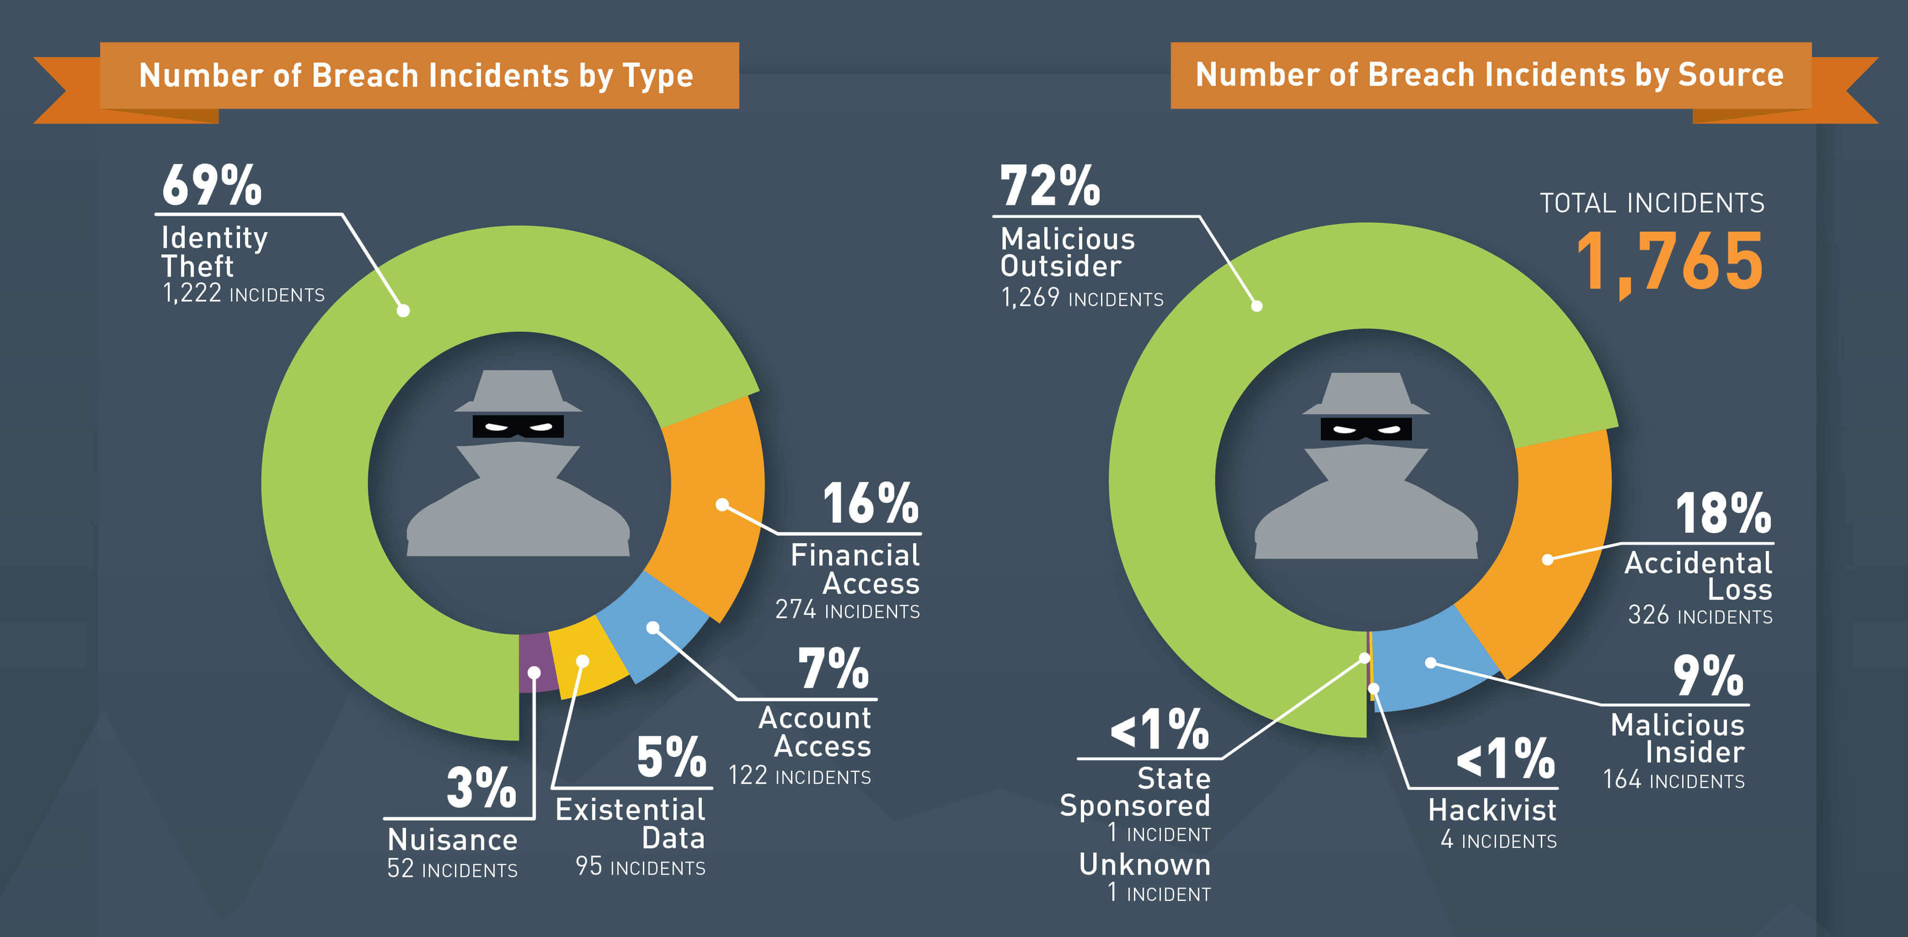

Slide 6
LITERATURE SURVEY
There has been a significant amount of research in this area in recent years. Some of the key ML algorithms used in IDS include:
Supervised Learning
Unsupervised Learning
Deep Learning
Some recent literature survey on IDS using ML:
"A literature survey on intrusion detection techniques" by R. S. R. Krishna et al. (2016) provides an overview of various traditional and ML-based IDS techniques.
"A comprehensive survey on deep learning for intrusion detection" by R. Li et al. (2019) focuses specifically on the use of DNNs for IDS.
"A survey of machine learning-based intrusion detection methods" by X. Liu et al. (2018) examines the use of various ML algorithms for IDS, including supervised, unsupervised, and deep learning methods.
It is important to note that while ML-based IDS can be quite effective, they are not foolproof and can still be bypassed by skilled attackers.
It is important to use multiple layers of security and to constantly update and improve the IDS to stay ahead of evolving threats.

Slide 7
PROBLEM STATEMENT
To design and develop an ML-based IDS that can accurately detect and classify malicious network activity in real-time by analyzing network traffic and identifying patterns that deviate from normal behavior.
The system should be able to adapt to new and evolving attacks and have a low rate of false positives. Furthermore, the system should be able to process large amounts of data and be efficient in terms of computational resources."
This problem statement highlights the key challenges and requirements of an ML-based IDS. The system must be able to accurately detect malicious activity while minimizing false positives and be able to adapt to new types of attacks.
It should also be able to process large amounts of data and be efficient in terms of computational resources.

Slide 8
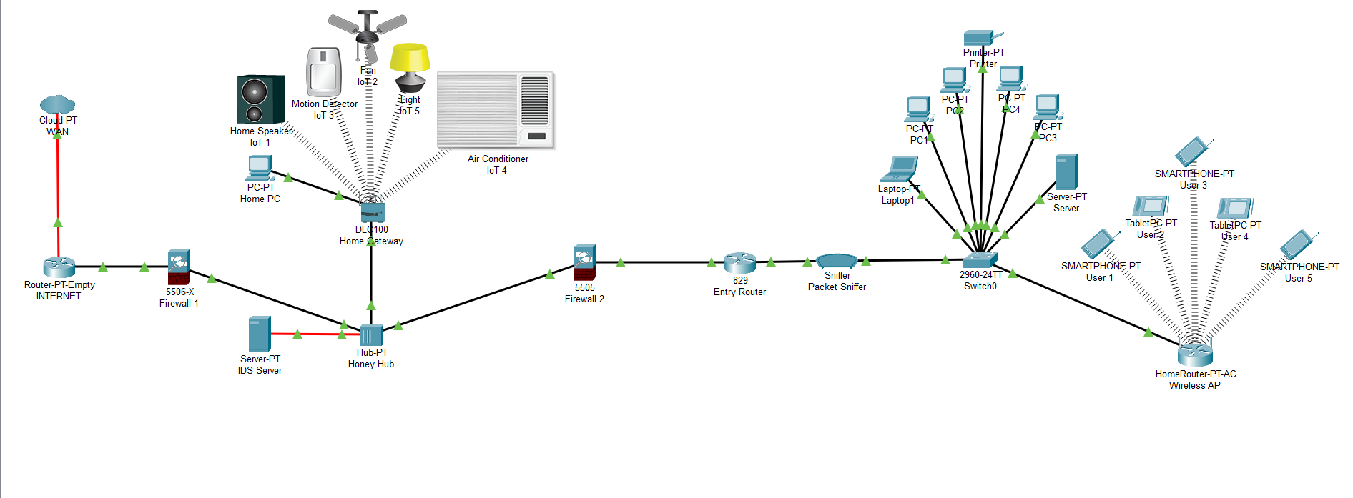
PROBLEM STATEMENT

Slide 9
MODULES
Network Design
Honeypot Creation
Dataset
Intrusion Detection System by Machine Learning
Threat Detection
GAN vs Other Models

Slide 10
HARDWARE AND SOFTWARE REQUIREMENTS
Hardware Requirements:
Computer with 2.5GHz Processing Power and 16 GB Memory in minimal.
Network Interface Card
Software Requirements:
Bash
Python3, C++
Network Monitor (Wireshark)
Virtual Machine: VMWare Workstation Virtual Network
Multiple OS – Kali Linux, Other Linux, Metasploit Linux
Code Editor: VS Code

Slide 11
REFERENCES
[1] Akshat Divya, Anchit Bhushan, Anand, Rishabh Khemka, Sumithra Devi K.HONEYPOT: Intrusion Detection System. International Journal of Education, Science, Technology and Engineering, vol. 3, no. 1, pp. 13-18, June 2020. DOI: 10.36079/ lamintang.ijeste-0301.66
[2] BO-XIANG WANG, JIANN-LIANG CHEN (2022): An AI-Powered Network Threat Detection System Doi 10.1109/ACCESS.2022.3175886
[3] Ritu Bala, Ritu Nagpal, "Intrusion Detection Based on Decision Tree Using Key Attributes of Network Traffic", Applications of Artificial Intelligence and Machine Learning, vol.778, pp.583, 2021.
[4] Philip Wester, Fredrik Heiding, Robert Lagerström, "Anomaly-based Intrusion Detection using Tree Augmented Naive Bayes", 2021 IEEE 25th International Enterprise Distributed Object Computing Workshop (EDOCW), pp.112-121, 2021.
[5] Gozde Karatas, Onder Demir, Ozgur Koray Sahingoz, "Deep Learning in Intrusion Detection Systems", 2018 International Congress on Big Data, Deep Learning and Fighting Cyber Terrorism (IBIGDELFT), pp.113-116, 2018.

Slide 12

TIME SLOT GANTT CHART

Slide 13
Thank you

